Slide 1
Introduction to ClaimCenter 7.0 Configuration
12 September 2011
Notes:
Introduction to CC 7.0 Configuration- <number>
Guidewire training materials contain Guidewire proprietary information that is subject to confidentiality and non-disclosure agreements. You agree to use the information in this manual solely for the purpose of training to implement Guidewire software solutions. You also agree not to disclose the information in this manual to third parties or copy this manual without prior written consent from Guidewire. Guidewire training may be given only by Guidewire employees or certified Guidewire partners under the appropriate agreement with Guidewire.

Slide 2
Lesson objectives
By the end of this lesson, you should be able to:
  Describe the general improvements in ClaimCenter 7.0 configuration
  This lesson uses the notes section for additional explanation and information.
  To view the notes in PowerPoint, choose View→Normal or View→Notes Page.
  If you choose to print the notes for the lesson, be sure to select “Print hidden slides.”
Notes:
Introduction to CC 7.0 Configuration- <number>

Slide 3
Lesson outline
ClaimCenter 7.0 configuration
Course outline
Notes:
Introduction to CC 7.0 Configuration- <number>

Slide 4


A brief history of ClaimCenter...
3.1
September, 2005
4.0
November, 2006
5.0
April, 2008
6.0
December, 2009
"Athena" platform
"Bedrock" platform
"Carbon" platform
7.0
September, 2011
“Diamond" platform
Notes:
Introduction to CC 7.0 Configuration- <number>
As of ClaimCenter 3.1, there was no separation of functionality between a "platform" and an "application". The ClaimCenter functionality resided in a single application.
As of ClaimCenter 4.0, functionality was divided between a platform and the application. Functionality common to all Guidewire applications (including PolicyCenter and BillingCenter) was moved to the platform. Functionality specific to ClaimCenter remained in the application. This platform was code-named "Athena".
ClaimCenter 5.0 is built on top of the "Bedrock" release of the platform.
ClaimCenter 6.0 is built on top of the "Carbon" release of the platform.
ClaimCenter 7.0 is built on top of the “Diamond” release of the platform.

Slide 5

The Guidewire platform
ContactManager
Data
Model
User
Inter.
ClaimCenter
PolicyCenter
BillingCenter
Bus.
Rules
Int.
APIs
Data
Model
User
Inter.
Data
Model
User
Inter.
Data Model
User
Inter.
Bus.
Rules
Int.
APIs
Bus.
Rules
Int.
APIs
Bus.
Rules
Int.
APIs
Guidewire Platform,
with a common technology for configuring...
Data
Model
User
Interface
Business
Rules
Integration
APIs
Notes:
Introduction to ClaimCenter - <number>
The Guidewire platform includes four main areas of technology. There is one area for configuring:
The data model, which defines the structure of the data.
The user interface, which defines the forms and fields the end user interacts with.
The business rules, which define and enforce business logic.
The integration APIs, which connect a given application to external applications, such as a reporting system or check printing system.
Every application uses this common technology to define its own data model, user interface, business rules, and integration APIs. Each application is distinct, but every application shares common abilities and configuration techniques with all the other applications.

Slide 6
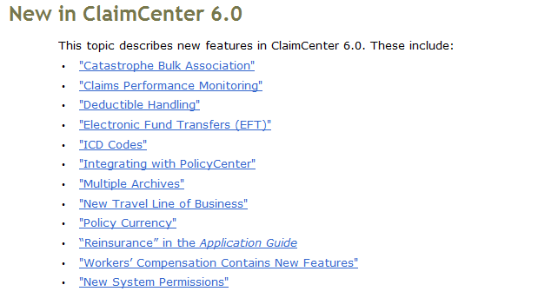
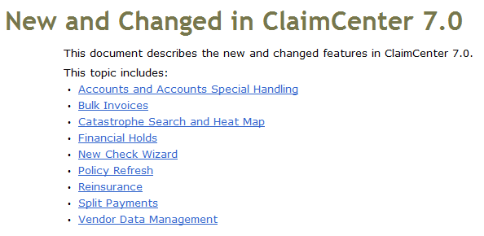
New and Changed guide
Upgrade Guide lists features new and changed in ClaimCenter 7.0 (and ClaimCenter 6.0)
Notes:
Introduction to CC 7.0 Configuration- <number>
The New and Changed Guide is one of the regular documentation guides.

Slide 7
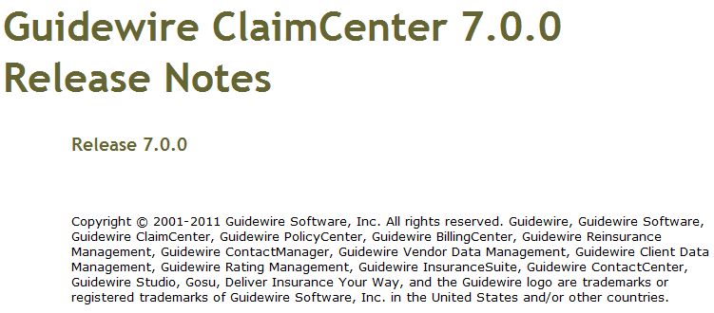
Release notes
Release Notes lists new and deprecated entities, fields, methods, typecodes and display keys
Notes:
Introduction to CC 7.0 Configuration- <number>
Release Notes are not published in a PDF format. They consist of an HTML file. Also, they are not included in the ClaimCenter.zip file, but they are often stored in the same directory containing the ClaimCenter.zip file.

Slide 8
Goals of Diamond and ClaimCenter 7.0
Platform:
  Continue to build out basic platform feature set
ClaimCenter 6.0
  Improve Homeowners and Workers' Comp lines of business
  Improve visibility of claims requiring attention
  Make general improvements
ClaimCenter 7.0
  Improve reinsurance visibility
  Improve catastrophe handling
  Fix policy refresh
  Add support for special handling
Notes:
Introduction to CC 7.0 Configuration- <number>

Slide 9
Lesson outline
ClaimCenter 7.0 configuration
Course outline
Notes:
Introduction to CC 7.0 Configuration- <number>

Slide 10
Course outline
Data model configuration
Carbon and Diamond Gosu improvements
LOB improvements
Claim performance monitoring
Additional improvements in ClaimCenter 6.0
Diamond UI and localization improvements
Claim archiving
Policy refresh
Claim reinsurance
Accounts & special handling
Financial holds
Catastrophe maps
Notes:
Introduction to CC 7.0 Configuration- <number>
Use sentence case for topics.

Slide 11
Lesson objectives review
You should now be able to:
  Describe the general improvements in ClaimCenter 7.0 configuration
Notes:
Introduction to CC 7.0 Configuration- <number>

Slide 12
Notices
Copyright © 2001-2011 Guidewire Software, Inc. All Rights Reserved.
Guidewire, Guidewire Software, Guidewire ClaimCenter, Guidewire PolicyCenter, Guidewire BillingCenter, Guidewire Reinsurance Management, Guidewire ContactManager, Guidewire Vendor Data Management, Guidewire Client Data Management, Guidewire InsuranceSuite, Guidewire ContactCenter, Guidewire Studio, Gosu, Deliver Insurance Your Way, and the Guidewire logo are trademarks or registered trademarks of Guidewire Software, Inc. in the United States and/or other countries.
This material is Guidewire proprietary and confidential. The contents of this material, including product architecture details and APIs, are considered confidential and are fully protected by customer licensing confidentiality agreements and signed Non-Disclosure Agreements (NDAs).
This file and the contents herein are the property of Guidewire Software, Inc. Use of this course material is restricted to students officially registered in this specific Guidewire-instructed course, or for other use expressly authorized by Guidewire. Replication or distribution of this course material in electronic, paper, or other format is prohibited without express permission from Guidewire.
    Guidewire products are protected by one or more of the following patents: U.S. Patent No. 7,885,831; U.S. Patent No. 7,788,296.
Notes:
Introduction to Guidewire Configuration - <number>

